Slide 1

Introduction to Logic Gates

Slide 2
Objectives
Understand the relationship between Boolean logic and digital computer circuits.
Learn how to design simple logic circuits.
Understand how digital circuits work together to form complex computer systems.

Slide 3
Boolean Algebra
Boolean algebra is a mathematical system for the manipulation of variables that can have one of two values.
In formal logic, these values are “true” and “false.”
In digital systems, these values are “on” and “off,” 1 and 0, or “high” and “low.”
Boolean expressions are created by performing operations on Boolean variables.
Common Boolean operators include AND, OR, and NOT.

Slide 4
What are Logic Gates?
Description …
Basic building blocks of a digital circuit
Data processing on the circuit is controlled using transistors
Output depends on the logic gate and the input
Input is one of two states – high or low
Output is one of two states – high or low
There are seven types of logic gates

Slide 5
What are Logic Gates?
There are three basic types of logic gate.
AND gate
OR gate
NOT gate

Slide 6
The AND Gate

Slide 7
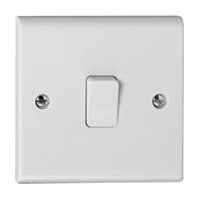


The AND Gate

Slide 8
The OR Gate

Slide 9
The OR Gate

Slide 10
The NOT Gate
The logical inverter

Slide 11
The NOT Gate

Slide 12
Logic Gates
AND GATE
1 AND 0 = 0
OR GATE
1 OR 0 = 1

Slide 13
True or False?
A
B
Q
The AND Gate
TRUTH TABLE
0
0
0
A
Q
0
1
0
B
1
0
0
1
1
1

Slide 14
True or False?
A
B
Q
The OR Gate
TRUTH TABLE
0
0
0
A
Q
0
1
1
B
1
0
1
1
1
1

Slide 15
True or False?
A
Q
The NOT Gate
TRUTH TABLE
0
1
A
Q
1
0

Slide 16
Combining Logic Gates
An AND gate and a NOT gate
A
C
Q
B

Slide 17
Combining Logic Gates
NAND gate
A
C
Q
B

Slide 18
Combining Logic Gates
A
B
C
Q
An AND and
NOT Gate (NAND)
TRUTH TABLE
0
0
0
1
A
C
0
1
0
1
Q
B
1
0
0
1
1
1
1
0
Q = NOT (A AND B)

Slide 19
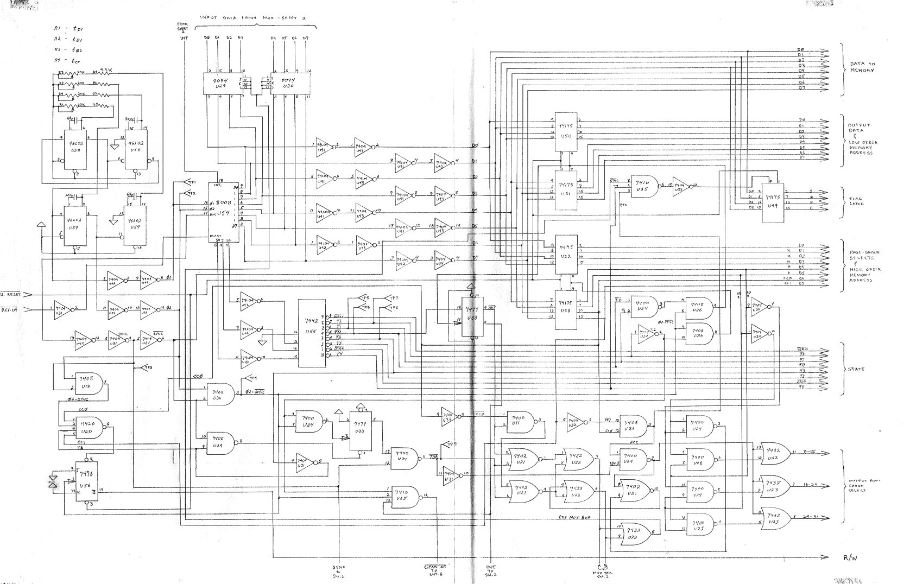
Combining Logic Gates
Notes:
Complex logic gates (Mr. Spock’s brain).

Slide 20
Experiment and Play …
http://logic.ly/demo/

Slide 21
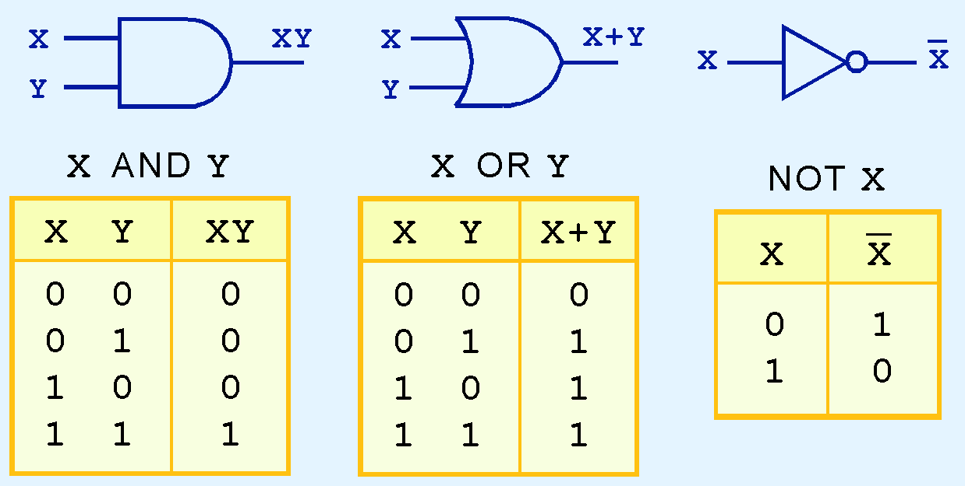
Logic Gates
The three simplest gates are the AND, OR, and NOT gates.
They correspond directly to their respective Boolean operations, as you can see by their truth tables.

Slide 22
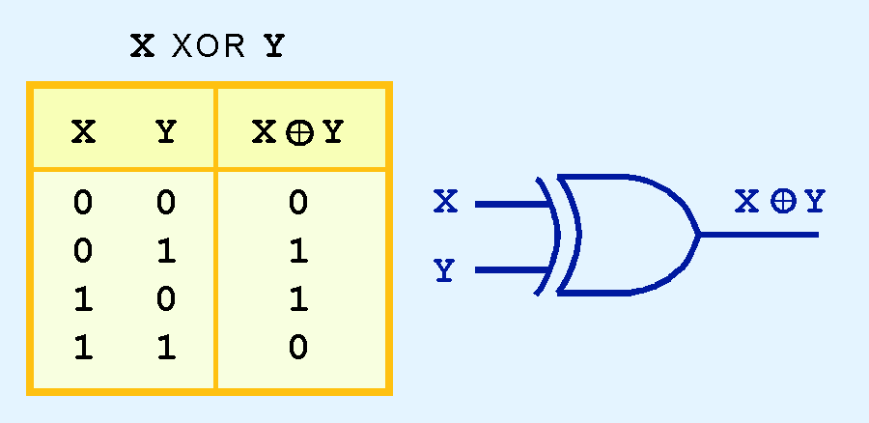
Logic Gates
Another very useful gate is the exclusive OR (XOR) gate.
The output of the XOR operation is true only when the values of the inputs differ.
Note the special symbol ⊕ for the XOR operation.

Slide 23
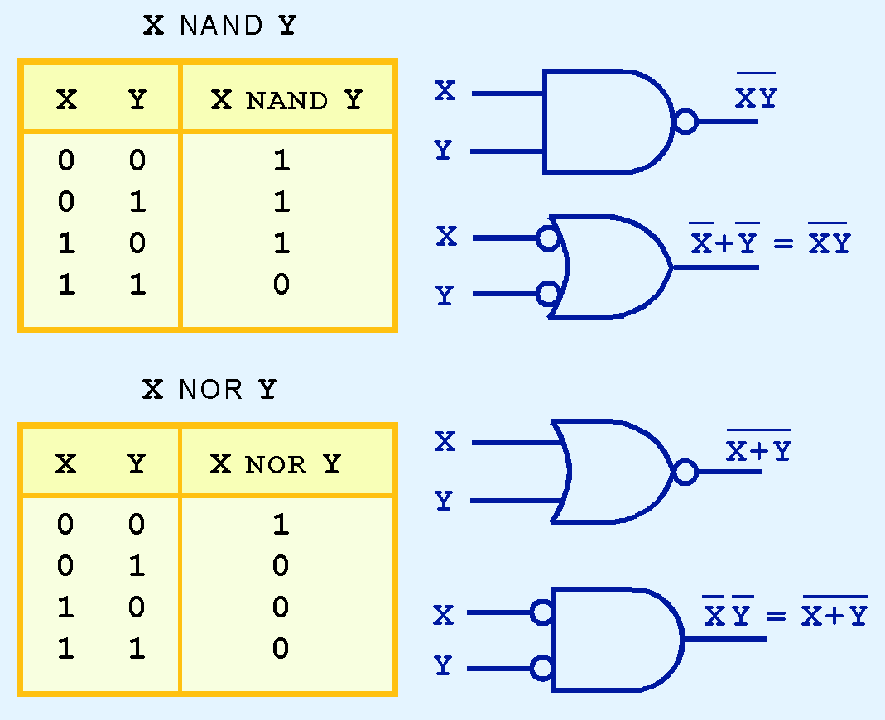
Logic Gates
NAND and NOR are two very important gates. Their symbols and truth tables are shown at the right.

Slide 24
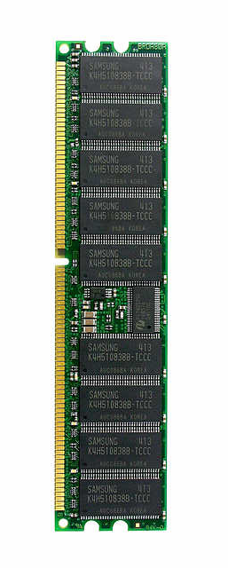
Memory
A flip-flop holds a single bit of memory
The bit “flip-flops” between the two NAND gates
In reality, flip-flops are a bit more complicated
Have 5 (or so) logic gates (transistors) per flip-flop
Consider a 1 Gb memory chip
1 Gb = 8,589,934,592 bits of memory
That’s about 43 million transistors!
In reality, those transistors are split into 9 ICs of about 5 million transistors each

Slide 25
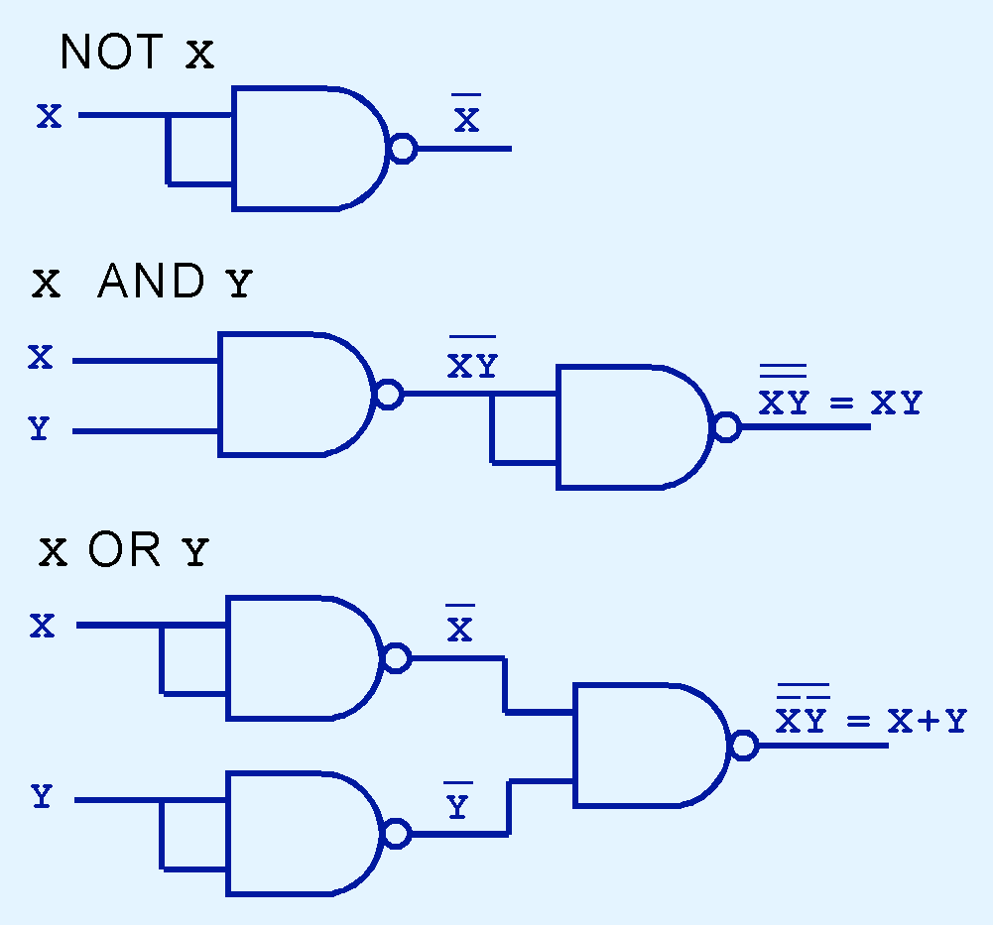
Combining Logic Gates
NAND and NOR are known as universal gates because they are inexpensive to manufacture and any Boolean function can be constructed using only NAND or only NOR gates.

Slide 26
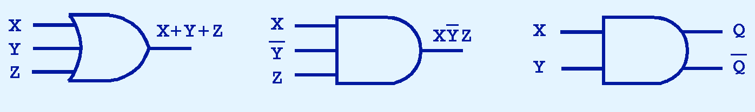
More Combining Logic Gates
Gates can have multiple inputs and more than one output.
A second output can be provided for the complement of the operation.
We’ll see more of this later.

Slide 27

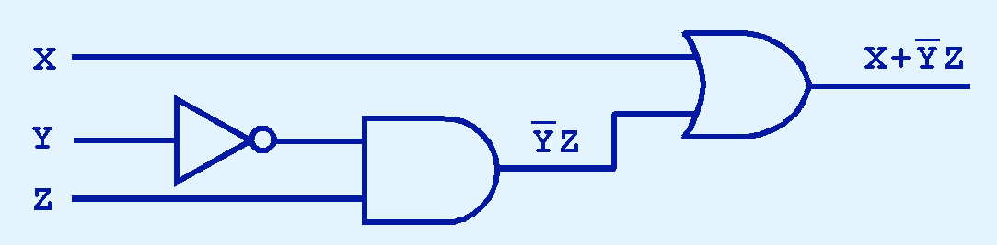
Combinational Circuits
We have designed a circuit that implements the Boolean function:
This circuit is an example of a combinational logic circuit.
Combinational logic circuits produce a specified output (almost) at the instant when input values are applied.

Slide 28
Combinational Circuits
We have designed a circuit that implements the Boolean function:
This circuit is an example of a combinational logic circuit.
Combinational logic circuits produce a specified output (almost) at the instant when input values are applied.

